Slide 1





Innovation In Data Analytics
November 7, 2018

Slide 2


Slide 3
UAE Health Insurance Market
Source: Insurance Authority Reports

Slide 4
UAE Health Insurance Market
Source: Insurance Authority Reports

Slide 5

Underlying Forces
An explosion of data and contents
Reliance on external data
An explosion in computing power
The rise of information activism
Self service BI

Slide 6
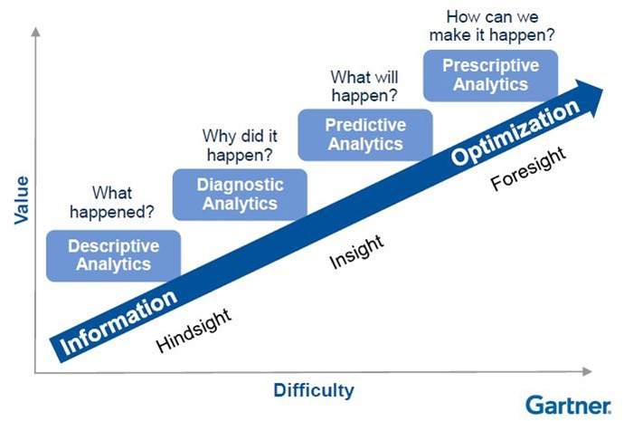
Analytics Maturity

Slide 7
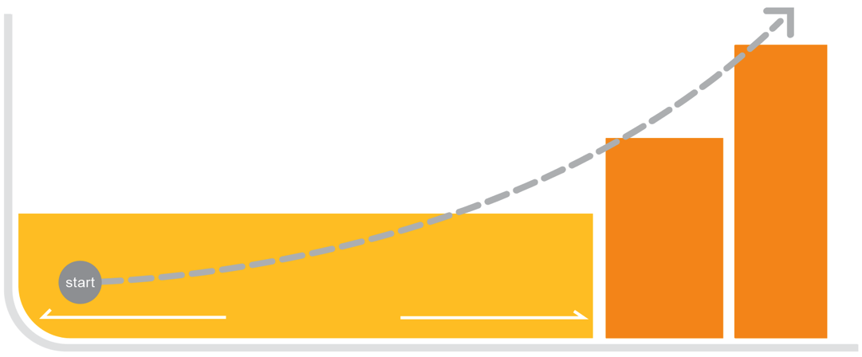
Maximizing analytic value
HIGH
Predictive
analytics
Analytic value
Diagnostic
analytics
Descriptive analytics
(What is likely
to happen?)
LOW
(Why did it happen?)
Reporting and viz tools
BUSINESS USERS
DATA SCIENTISTS
Need to combine all in one tool

Slide 8
Difference Between Flat Reports and BI
Criteria | Operational Reports | Business Intelligence
Business Function | Tactical | Analytical
Users | Staff | Executive Management, Analysts, LOB Heads
Data Sources | Core system Only | Any including core e.g. TPA Data
Mode of Operation | Query then Analyze | Analyze then query (on the go)
Type | Static | Dynamic
KPI Measurement | No | Yes
Real Time | Yes | Near Real Time
Analysis Across Subject Areas | No | Yes e.g. Combined Ratio (as it has expenses, etc)

Slide 9


&

Slide 10

Difference among FWA?
The primary difference among Fraud, Waste and Abuse is intent and Knowledge. Fraud requires intent to obtain payment and knowledge that the actions are wrong.
Waste and Abuse may involve obtaining an improper payment or creating an unnecessary cost , but does not require the same intent and knowledge.
When fraud is committed, the company has right to take action against the fraudulent act and suspend them. Monetary penalties also implemented.
On the other hand Abuse is lesser offensive.
When abuse is committed , the company usually
may be able to recover the payments.

Slide 11

How it Impacts?
Increase in Medical Cost
Every time when the claim is identified as Fraud, Waste or Abuse it increase the overall medical cost.
Increases in Premium
A fraudulent claim history will automatically increase premium amounts. As rates increase, it will increase the deductibles and co-payments and/or reduction in benefits that you used before.
Reduction in Benefits
Medical policies usually have annual limits, so every time a fraudulent case occurs in your name, a part of your limit gets deducted. Also over time the employer reduces benefits to save costs

Slide 12

Facts about
FWA

Slide 13

Facts
The World health report 2010 estimated that about 20-40% of all health sector resources are wasted and highlighted health care leakages-waste, corruption and fraud-as the ninth leading source of inefficiency of health systems.
The UAE is ranked 10th on a global list of efficient
health care.
The exact rates of claims fraud, waste and abuse are difficult to determine but recent figures from regional industry and regulatory bodies suggests that ‘figures allude to the notion that as much as 10% of claims are fraudulent and as little as 20% of these are detected’, and global figures range from 5 % to 15 %

Slide 14

Who can be involved in FWA?
There are many types of healthcare fraud, which can be committed by:
Members/Patient
Employees
Providers/Prescribers
Pharmaceutical Companies
Pharmacies

Slide 15
Who can be involved in FWA?
By Members/Patient
Misrepresentation of eligibility Status
Member intentionally allows someone to use his or her insurance card to avail health care services
Health plan member may abuse in such a manner that he or she is receiving prescriptions from multiple physicians, or filling prescriptions at multiple pharmacies.
A member obtains prescription drugs and sells it to someone else in the market to make money
A member stocks a large quantity of drugs to avoid out of pocket costs
Some times members consult several doctors to obtain prescription for painkillers and other addictive drugs
By Providers
Billing for medically unnecessary services/procedures
Up coding (using procedures or diagnosis codes that pay at a higher rate)
Routinely submitted duplicate claims
Billing for services not rendered

Slide 16
Who can be involved in FWA?
By Pharmacies
Multiple billing for the same prescription
Billing for non-existent prescriptions
Billing for brand drugs when substitutes are available in the market with lower rates
By Pharmaceutical Companies
Pharmaceutical Companies offer kickbacks and other facilities to the Doctors/Physician to prescribe their products more.

Slide 18
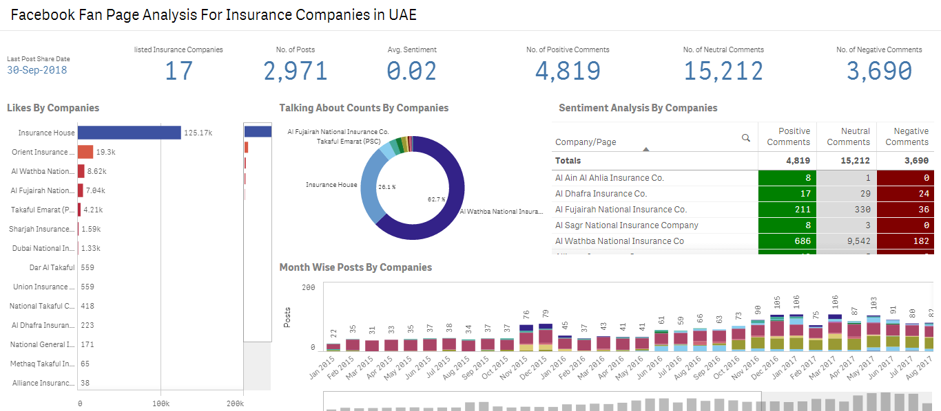
Facebook Analysis - Insurance

Slide 19
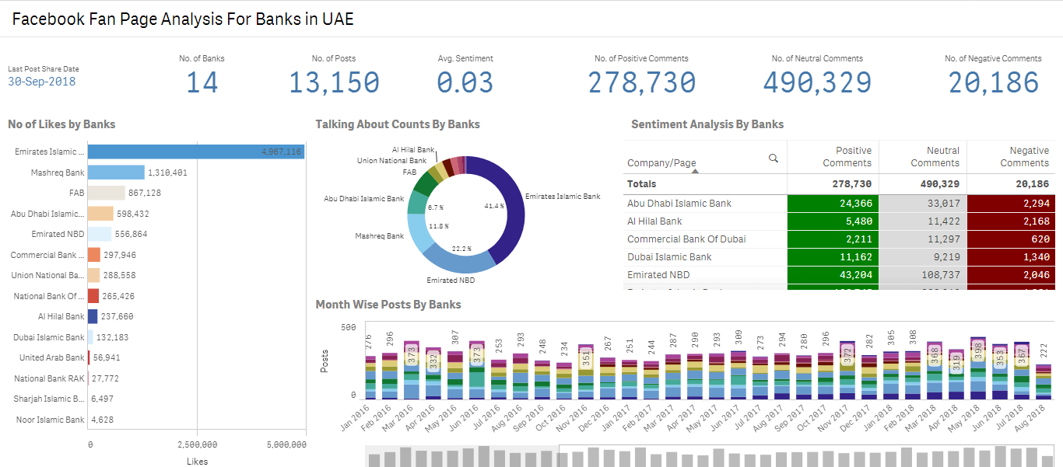
Facebook Analysis - Banks

Slide 20
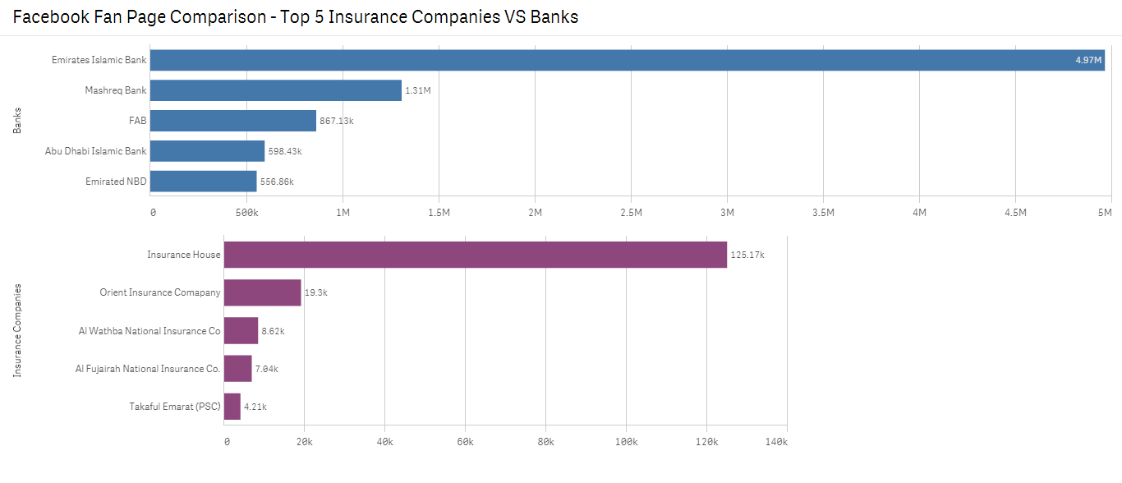
Insurance vs Banks

Slide 21
Use of Systems for Fraud
Historical / Retrospective
Predictive / Real Time
Standard Reports
Utilization per provider
Provider KPIs
Statistical Reports
Distribution of claims by provider
By diagnosis / treatment
Determ-inistic Rules
Rule edits
Diagnosis / treatment rules
Complex Probab-ilistic Rules
Averages per diagnosis
Calculate scores for claim
Calculate scores for patient based on past history
Historical data / experience will help create new rules and setup complex probabilities.

Slide 22

FWA Indicators/Flags
Some of the FWA Indicators are as follows:
Gap within consecutive consultations by same and different diagnosis, clinicians, providers.
Duplicate billings, Same-day billings.
Monthly analysis of member claims, identify trend and spikes.
High utilization/billing from providers, members for single or multiple items.
Clinician prescribing too many units of particular drugs to everyone.
Pattern of drug utilization by member.
Units of services per Invoice.
Injection without drugs.
Invoices with high amounts.
Invalid codes against services.
Rejection Rates by Providers.
Multiple invoices against single member in one day for single provider.
Treatment vs Diagnosis for high frequency claims.
Primary vs Secondary Diagnosis for high frequency claims.

Slide 23
FWA Indicators/Flags
Some of the FWA Indicators are as follows:
Doctors, who treated whopping, say 50+ patients in a day.
Providers administering far higher rates of tests than others.
Providers costing far more, per patient basis, than others.
Providers with high ratio of distance patients.
Providers prescribing certain drugs at higher rate than others.
Multiple medical opinions/providers
Changing providers for the same treatment (possibly correlated with other claim activity)
High number of treatments for type of injury
Abnormally long treatment time off for the type of injury
Providers administering more expensive tests and equipment (up-coding).
Providers multiple-billing for services rendered.
Providers unbundling or billing separately for laboratory tests performed together to get higher reimbursements.
Providers charging more than peers for the same services.
Providers conducting medically unrelated procedures and services.
Policy holders traveling long distance for treatment which may be available nearby.

Slide 24
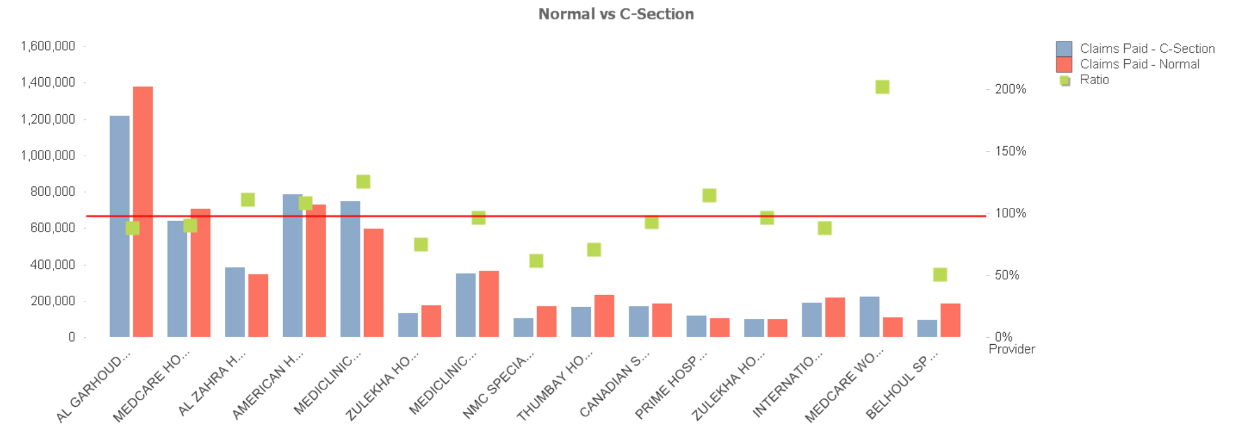
Normal Vs C-Section

Slide 25
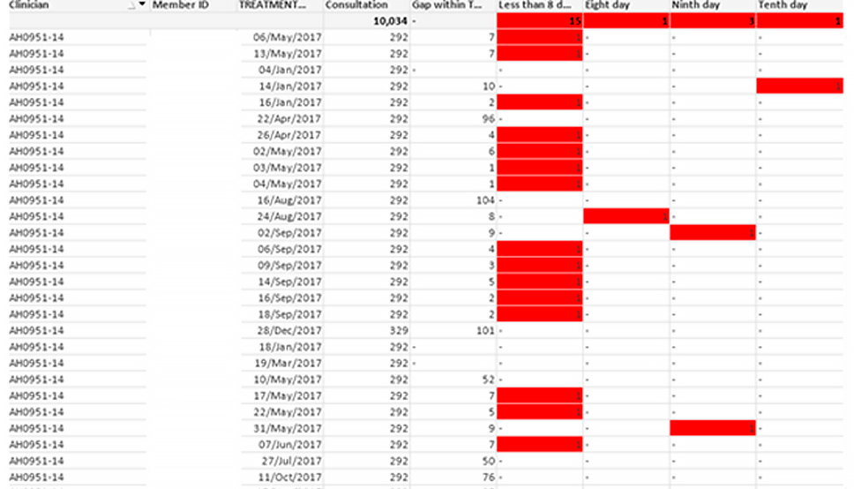
Gap within Consultations

Slide 26
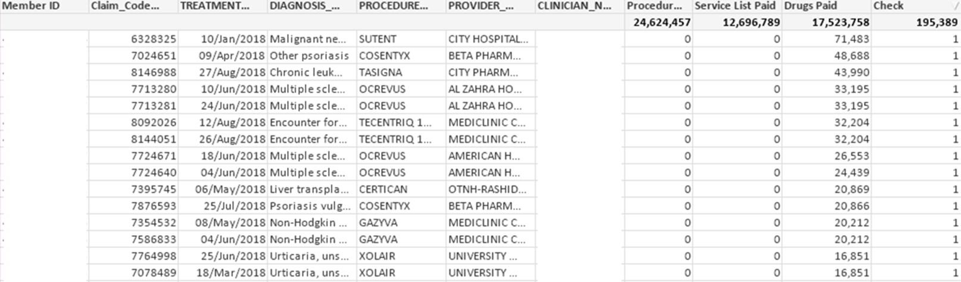
Pharmacy without Consultations

Slide 27
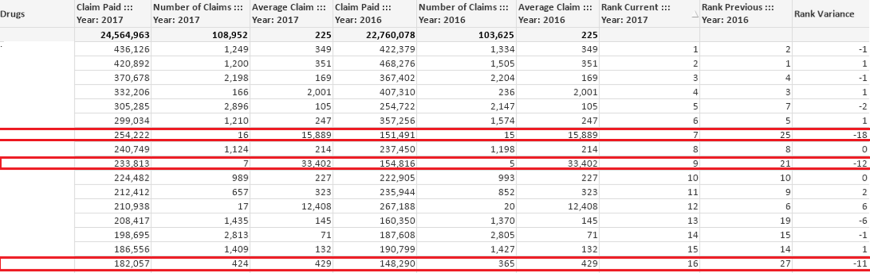
Drugs Rank Analysis

Slide 28
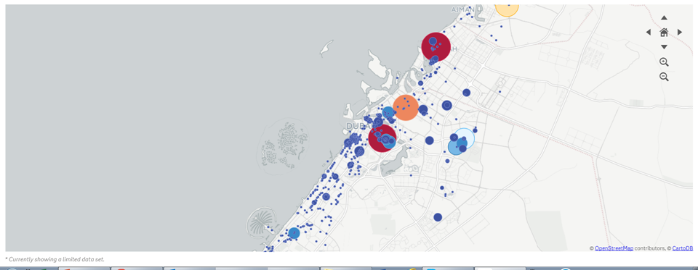
Risk Utilization Visually
We can show utilization by geography also and the spots would be updated based on selections. The size and colour can represent different dimensions.

Slide 29
Excessive Usage by Patient

Slide 30
Are you data driven
Data Denial
You distrust data and avoid using it
Data Indifferent
You don’t care about data and have no need for it
Data Informed
You use it only when it supports your opinions or decisions
Data Driven
You use it to shape and evaluate all your decisions
This is one time cost that reaps ongoing benefits. No use reinventing the wheel
To become a Data Driven Company it has to come from top

Slide 31



DUBAI
KSA
PAKISTAN
2107 SIT Towers,
PO Box 341486,
Dubai Silicon Oasis,
Dubai, UAE
Phone: +971-4-3207-250
Fax: +971-4-3207-260
United Co. For Actuarial Services
Riyadh,
KSA
Phone: +966 50 5413065
Office 52/53 – B
5th Floor
Shahrah-e-Liaquat
Karachi, Pakistan
Phone: +971-4-3207-250
www.badriconsultancy.com
info@badriconsultancy.com

